Slide 1

Design Technology for the trillion-device Future
Alberto Sangiovanni-Vincentelli
The Edgar L. and Harold H. Buttner Chair of EECS, University of California at Berkeley

Slide 2
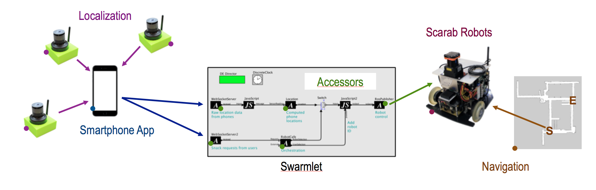
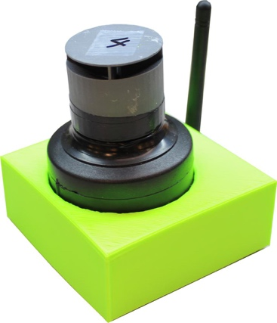
SwarmBox Delivery Service (STARnet Arena, Area A1)
ALPS Localization
ALPS is an ultrasonic localization system that localizes unmodified smartphones to with 30 cm error. ALPS anchors can self-localize by walking a smartphone around a new space, lessening the burden of installing the system.
Notes:
Indoor localization and autonomous robots combine to provide a seamless experience to enable a “one-click” swarm delivery service. A smartphone app provides a menu of choices, and a single click results in the item being delivered to you.
The ALPS ultrasonic indoor localization system provides precise location data of the smartphone while the user makes a selection. The location data and item selection are fed to a nearby Swarmlet that processes the incoming data and dispatches a robot to the user’s location. The robot uses a human-friendly navigation algorithm to find a path to the user, while avoiding obstacles, to complete the delivery.

Slide 3

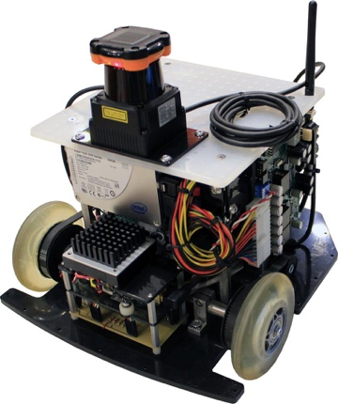
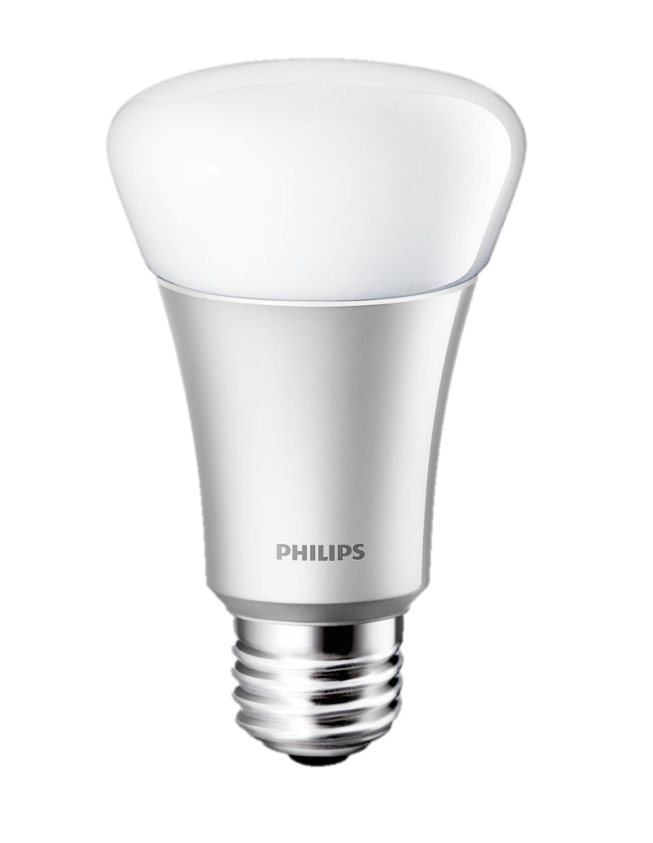
SwarmBox Delivery Service: Technology
ALPS
Localization
Accessors
& Ptolemy II
Scarabs & Navigation
Accessors/Ptolemy II
Notes:
ALPS Localization. ALPS is an ultrasonic localization system that localizes unmodified smartphones to with 30 cm error. ALPS anchors can self-localize by walking a smartphone around a new space, lessening the burden of installing the system.
Accessors & Ptolemy. Accessors provide a sandboxed JavaScript environment for interacting with physical devices, including robots, smart devices, and other networked devices. They execute inside of the Ptolemy II modeling and simulation tool.
Scarabs & Navigation. Scarab robots are relatively low-cost ground robots that run the open-source ROS operating system for robots. They use “human-friendly” navigation to follow a path while avoiding people in the same space.
Integration/Reconfigurability. Using Accessors and a Swarmlet provides a GUI based editor for easily reconfiguring how the application runs. Adding status indications or alternate localization services is simply a matter of dropping in new Accessors, connecting the ports, and re-running the Swarmlet.

Slide 4
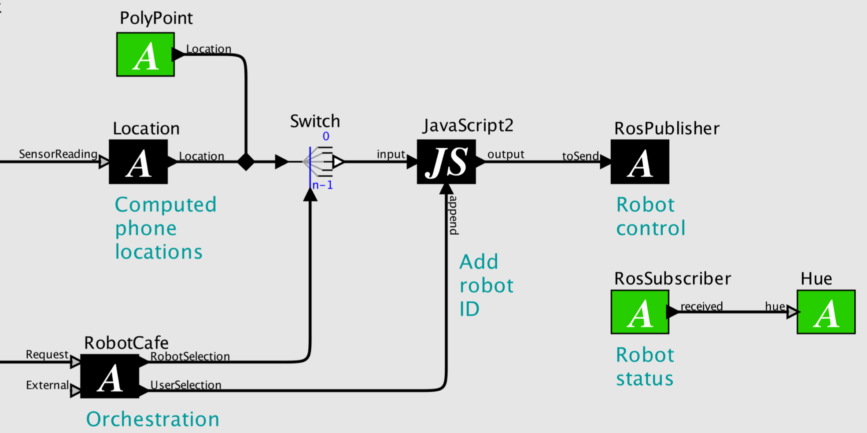
SwarmBox Delivery Service: Integration
ALPS
Localization
Accessors
& Ptolemy II
Scarabs & Navigation
Accessors/Ptolemy II

